Slide 1
I Live in
Zhuhai! 🐚
A Speech by ______, Age 6

Slide 2
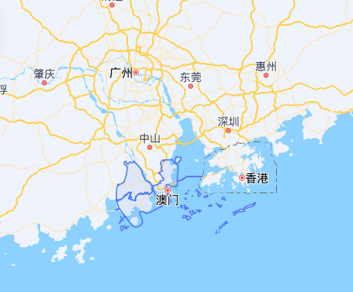
📍 Where is Zhuhai?
📍 Guangdong Province
In the south of China, next to Macau
and Hong Kong. Right by the beautiful
South China Sea! 🌊
🏙️ A Beautiful Coastal City
Zhuhai is known as the 'Romantic City'.
It has beaches, islands,
and mountains! ⛱️
🚀 Special Economic Zone
One of China's first! Many cool
companies are here —
like Gree Electric! 🏭
1 / 9

Slide 3
☀️ What's the Weather Like?
☀️
🍂
Summer
Hot & sunny! 🌞
25°C – 33°C
Perfect for the beach!
Autumn
Cool & comfy! 🍃
20°C – 28°C
The best season!
❄️
🌺
Winter
Not too cold! 🧣
10°C – 20°C
No snow, just cozy!
Spring
Warm & flowery! 🌸
18°C – 26°C
Everything blooms!
2 / 9

Slide 4
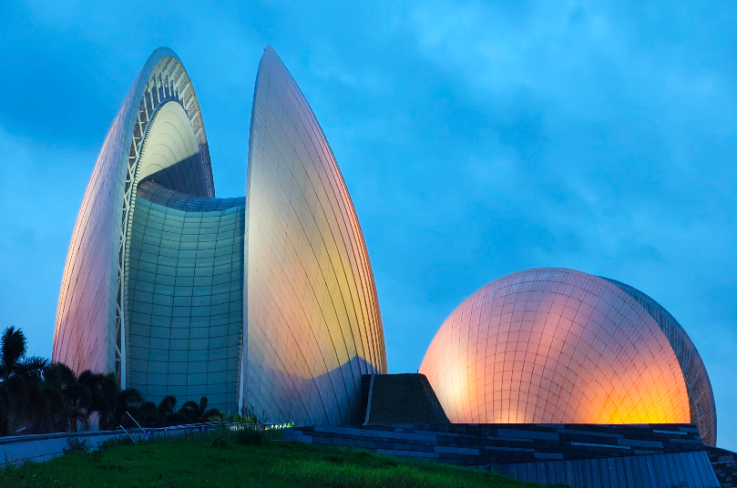
🏛️ Famous Places in Zhuhai
Zhuhai Grand Theater
(Sun and Moon Shells)
🐚 日月贝
🐚 It looks like two giant seashells!
🌊 Built on an island — the only
seaside opera house in China!
🎵 We can watch concerts and shows.
🌙 At night, it lights up — magical!
3 / 9

Slide 5
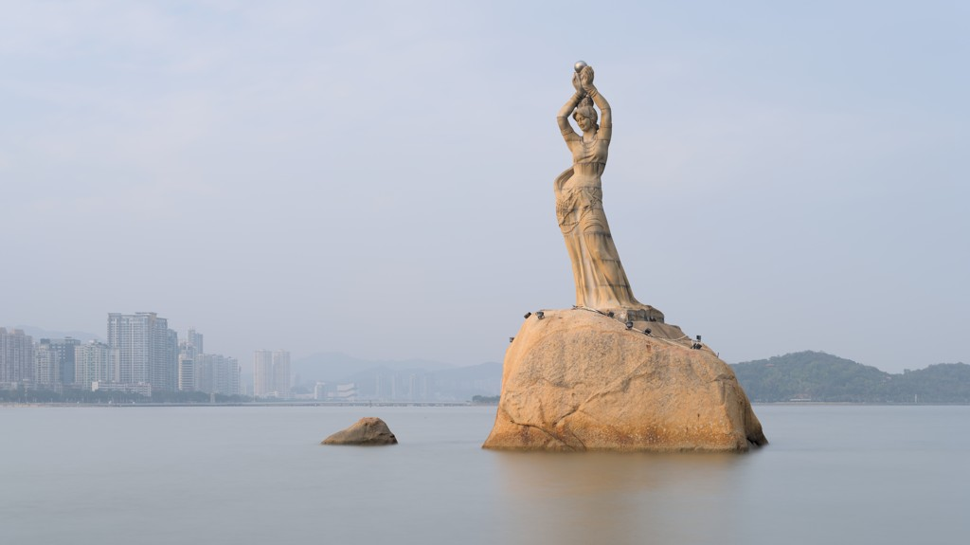
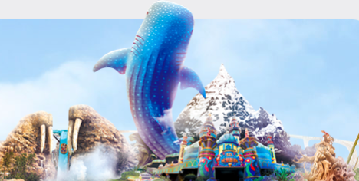
⭐ More Amazing Places!
Fisher Girl 🧜‍♀️ 珠海渔女
Ocean Kingdom 🐋 横琴长隆
🐟 A beautiful statue by the sea
💎 She holds a pearl up high
❤️ The symbol of Zhuhai city!
🐳 World's biggest ocean park!
🦈 See whale sharks and penguins
🎢 Super fun rides and fireworks!
4 / 9

Slide 6
🍽️ Yummy Zhuhai Food!
🦐
🦪
🍵
Fresh Seafood
Shrimp, crab, fish —
caught right from the
South China Sea! So
fresh and delicious!
Oysters!
Zhuhai is famous for
oysters. We eat them
steamed, grilled,
or in soup!
Dim Sum
Just like Hong Kong!
Shrimp dumplings,
pork buns, and
sweet egg tarts. Yum!
5 / 9

Slide 7
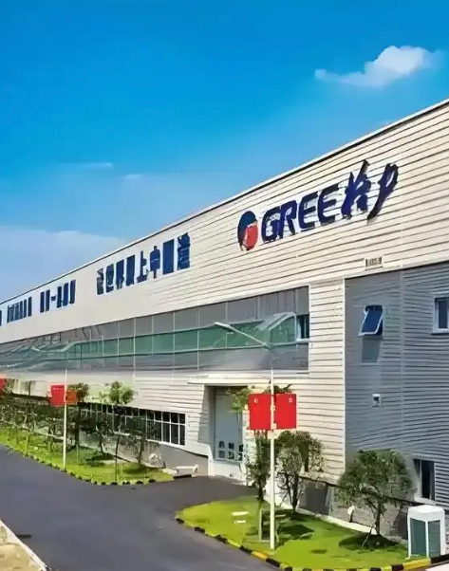
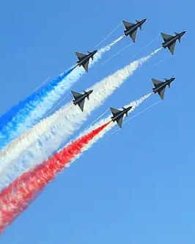
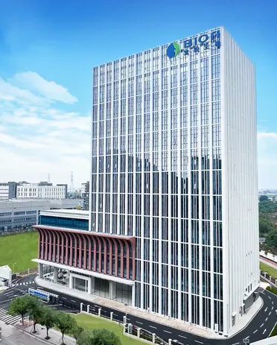
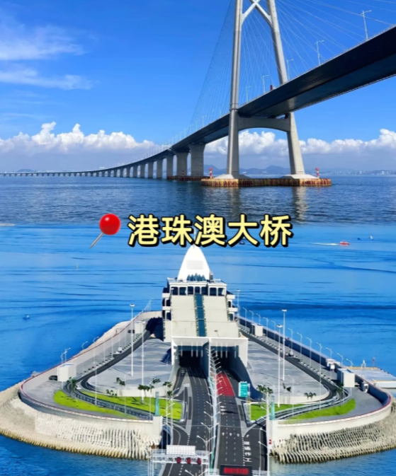
🏭 What Does Zhuhai Make?
🏭
Gree Electric
The world's biggest air conditioner
maker! Many families in China
use Gree AC at home.
✈️
Airshow China
Zhuhai hosts China's biggest
airshow! We see cool fighter jets
and rockets every two years.
🧬
Biotech
Zhuhai makes special materials for
labs and hospitals. They help
doctors and scientists!
🌉
HK-Zhuhai-Macau
Bridge
The world's longest sea bridge!
Connects Zhuhai to Hong Kong
and Macau. 55km long!
6 / 9

Slide 8
🌟 Fun Facts About Zhuhai!
🏝️
🌉
🏆
📅
146
55 km
#1
1980
islands belong to
Zhuhai! We can take
boats to visit them.
HK-Zhuhai-Macau
Bridge — the world's
longest sea crossing!
Zhuhai is ranked as
one of China's most
livable cities!
Zhuhai became a
Special Economic
Zone that year!
7 / 9

Slide 9
Thank You!
谢谢大家! 🙏
I love my city — Zhuhai! 🐚❤️
8 / 9

